Slide 1

Electronic System for Navigation of Visually Impaired People​
ICPCSN 2022
Vishwakarma Institute of Technology, Pune
2nd International Conference on Pervasive Computing and Social Networking
Narasu's Sarathy Institute of Technology Salem, India
Paper id - ICPCSN046

Slide 2
Authors
Prof. Jyoti Madake
Bhumika Bijane
Abhijeet Chine
Geetai Charde
Dr. Shripad Bhatlawande
Dr. Swati Shilaskar

Slide 3
Index
01
INTRODUCTION
02
LITERATURE REVIEW
03
RESEARCH GAP
04
NOVELTY
05
METHODOLOGY
06
RESULTS
3
07
CONCLUSION

Slide 4
01
INTRODUCTION

Slide 5
Introduction
Vision is crucial for seeing the world around
Globally 253 million visually impaired people
Secure and Independent Mobility is a challenge
Mobility and Navigation assistance using Electronic Travel Aid

Slide 6
02
LITERATURE REVIEW

Slide 7
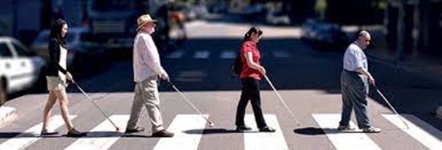
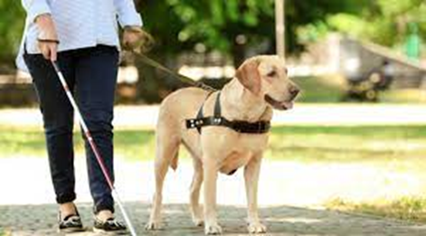
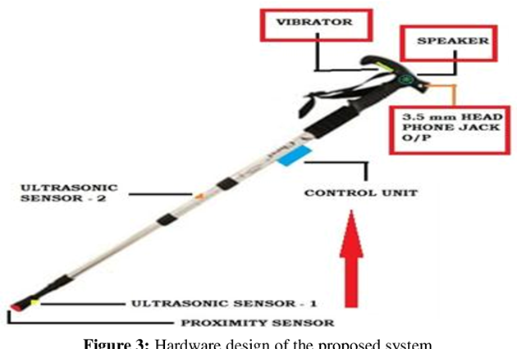
Literature Review
1. White cane
2. Guide dog
3. Medico Stick
Most basic, adaptable, reliable and low-maintenance assistive device
A guide dog is useful to detect and avoiding barriers in the course of travel
This device has an attached DTMF device with 5 sensors

Slide 8
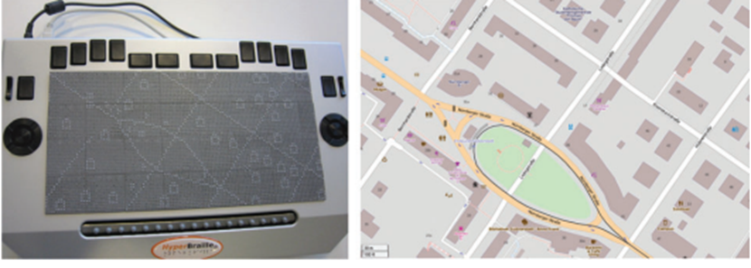
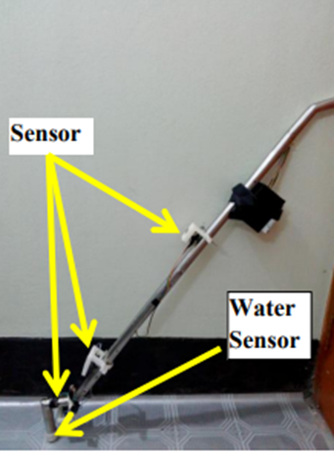
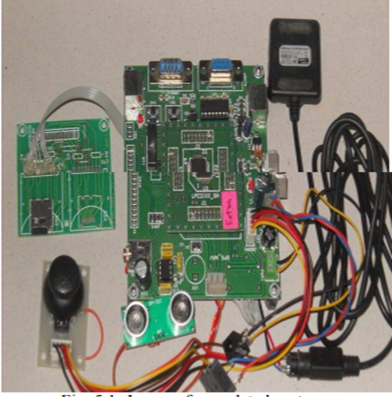
4. Reading maps
5. Ultrasonic based
6. GPS Based
Employs a touch-sensitive pin-matrix display and represents various map elements
Complete prototype.
Three ultrasonic sonar sensors used
Uses GPS and voice recognition along with obstacle avoidance
Latitude and longitude values are received continuously from the GPS receiver

Slide 9
Research Gap
Bulky and Heavy-Weight
Lack of useful function
Acceptability among visually impaired
Expensive

Slide 10
Novelty
Local map dictionary based customized navigation
Accurate detection of road intersection and turns
Portable
User friendly
Simplified audio feedback

Slide 11
03
METHODOLOGY

Slide 12
Block Diagram
Numeric keypad
Processor Based System
Earphones
Internet Dongle

Slide 13
Dataset-1
loc_id | location | latitude | longitude
0 | VIT | 18.4636235448827 | 73.8681970215453
1 | Dolphin Chowk | 18.4613530985777 | 73.8663197174780
2 | Sukhsagar Nagar | 18.4565318847273 | 73.8701151005911
3 | Lake Town | 18.4574398192754 | 73.8640314780571
4 | Pune Manapa Bus Station | 18.5231950605349 | 73.8538378691473
5 | Chintamani Nagar | 18.4663130611137 | 73.8661892368290
6 | Mahesh Society | 18.4690560005604 | 73.8650557445310
7 | Bibewadi Police Station | 18.4673373998633 | 73.8641499107465
8 | Kk Market | 18.4698715835638 | 73.8584392147734
9 | Swargate Busstand | 18.4971512765214 | 73.8580622798786
Source and
Destination

Slide 14
Dataset-2
waypt_start_id | waypt_stop_id | waypt_seq | waypt_lat | waypt_long | waypt_nm
0 | 1 | 1 | 18.4636423060993 | 73.8672999807301 | Supriya Cafe
0 | 1 | 2 | 18.4622745152536 | 73.8673792512366 | Upper Market Road
0 | 1 | 3 | 18.4610524809038 | 73.8674828721393 | Upper Indira Nagar Corner
0 | 2 | 1 | 18.4609669931155 | 73.8674884242009 | Bibwewadi Road - Rajeev Gandhi
0 | 2 | 2 | 18.4609436766806 | 73.8691353780357 | Diamond Jerish Mutton And Chicken
0 | 2 | 3 | 18.4567098740135 | 73.8694264106621 | J M D Mobile Skins
0 | 3 | 1 | 18.4636284039618 | 73.8672999363589 | Supriya Cafe
0 | 3 | 2 | 18.4631849815724 | 73.8653757103069 | Bansilal Path
0 | 3 | 3 | 18.4629471970441 | 73.8650597723761 | Swami Vivekanand Road
0 | 3 | 4 | 18.4607472799199 | 73.8651395928063 | Lake Town Road
0 | 3 | 5 | 18.4599400622288 | 73.8649836149626 | Hanuman Mandir
Waypoints

Slide 15
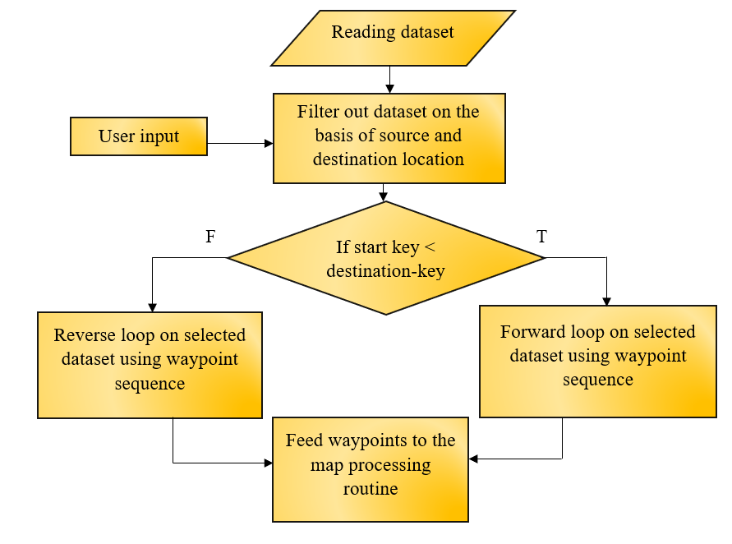
FL0WCHART-1
Calculating
waypoints

Slide 16
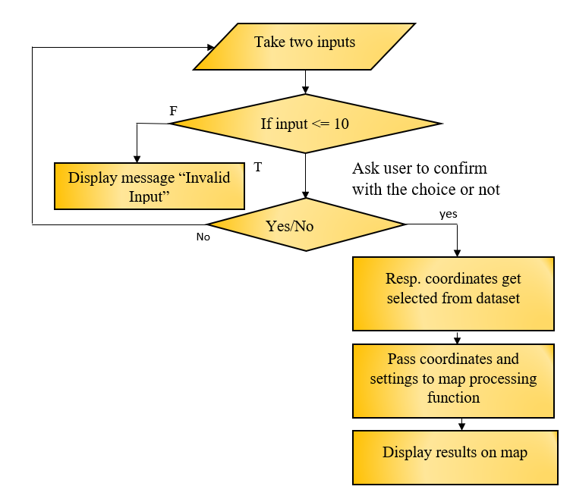
FL0WCHART-2
Path Planning

Slide 17
Overall Working
Most frequently preferred locations
User choice for navigation using keypad
Calculate waypoints
Output on Map
Path Planning
Audio Output

Slide 18
04
Result

Slide 19
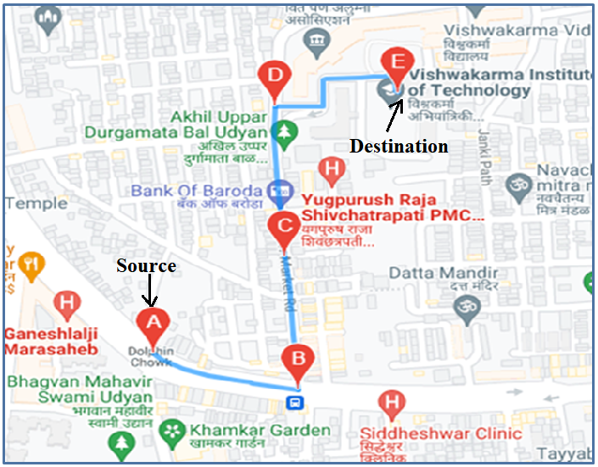
Results :
Source location as Dolphin Chowk
Destination location as V I T
Total 3 waypoints

Slide 20
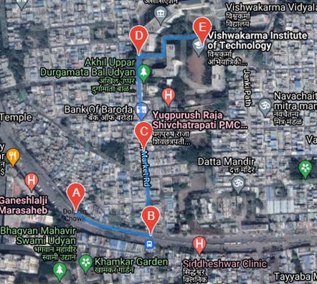
The route is also verified using satellite view.

Slide 21
Advantages
Local area navigation
User friendly interface
Cost-effective and Efficient
Portable
Long-lasting navigational choice
Limitation
Google API accuracy concern

Slide 22
04
Conclusion

Slide 23
Conclusion
Local map dictionary based customized navigation
Guidance for frequently traveled path
User friendly audio feedback
A GPS can be added to track the user
Possible extension to include alternate routes
23

Slide 24
References
J. Faria, S. Lopes, H. Fernandes, P. Martins and J. Barroso, "Electronic white cane for blind people navigation assistance," 2010 World Automation Congress, 2010, pp. 1-7.
K. Iwatsuka, K. Yamamoto and K. Kato, "Development of a guide dog system for the blind people with character recognition ability," Proceedings of the 17th International Conference on Pattern Recognition, 2004. ICPR 2004., 2004, pp. 453-456 Vol.1, doi: 10.1109/ICPR.2004.1334161
Shrivastava, Prasun, Praveen Anand, Akash Singh, and V. Sagar."Medico stick: An ease to blind & deaf." In 2015 2nd International Conference on Electronics and Communication Systems (ICECS), pp. 1448-1452. IEEE, 2015.
Wang, Z., Li, N., Li, B.: Fast and independent access to map directions for people who are blind. Interact. Comput. 24, 91–106 (2012)
Mohapatra B. N., Mohapatra R. K., and Panda P.. "Path guidance system for blind people" International Journal of Open Information Technologies, vol. 7, no. 5, 2019, pp. 29-32.
Loomis, Jack M., Reginald G. Golledge, and Roberta L. Klatzky. "GPS-based navigation systems for the visually impaired." Fundamentals of wearable computers and augmented reality 429 (2001): 46

Slide 25
Patel, Samir, Amit Kumar, Pradeep Yadav, Jay Desai, and Dipali Patil. "Smartphone-based obstacle detection for visually impaired people." In 2017 International Conference on Innovations in Information, Embedded and Communication Systems (ICIIECS), pp. 1-3. IEEE, 2017.
Dhod, Rahul, Gurmohan Singh, Gagandeep Singh, and Manjit Kaur. "Low cost GPS and GSM based navigational aid for visually impaired people." Wireless Personal Communications92, no. 4 (2017): 1575-1589.
A. Noorithaya, M. K. Kumar and A. Sreedevi, "Voice assisted navigation system for the blind," International Conference on Circuits, Communication, Control and Computing, 2014, pp. 177-181, doi: 10.1109/CIMCA.2014.7057785.
Mohapatra B. N., Mohapatra R. K., and Panda P.. "Path guidance system for blind people" International Journal of Open Information Technologies, vol. 7, no. 5, 2019, pp. 29-32.
J. Borenstein and I. Ulrich, "The GuideCane-a computerized travel aid for the active guidance of blind pedestrians," Proceedings of International Conference on Robotics and Automation, 1997, pp. 1283-1288 vol.2, doi: 10.1109/ROBOT.1997.614314.
Farcy R., Bellik Y. (2002) Locomotion Assistance for the Blind. In: Keates S., Langdon P., Clarkson P.J., Robinson P. (eds) Universal Access and Assistive Technology. Springer, London.

Slide 26

Thank You!!

